Slide 1

Week 3 Practical: ADFGVX and Vernam Cipher
CT5046 Cryptography and Security
University of Gloucestershire

Slide 2
Overview
Recap
ADFGVX cipher
Vernam cipher
Bringing it all together
Post-sessional work

Slide 3
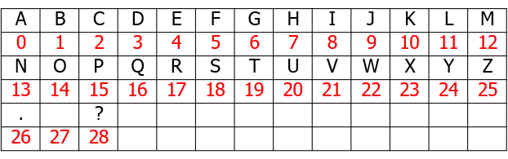
Alphabet index

Slide 4
Recap
Last week, we established that classical ciphers can be classified into:
Substitution ciphers
Polygraphic ciphers
We looked at Hill and Playfair ciphers as examples of substitution ciphers
This week we will look at ADFGVX cipher and Vernam cipher

Slide 5
ADFGVX Cipher

Slide 6
ADFGVX Cipher overview
Was introduced in 1918
Combination of substitution and transposition
Involves the use of a 6x6 grid consisting of randomised alphanumeric characters
Arrangement of the elements in the grid is part of the key

Slide 7
Example
Suppose that we have a plaintext P = HELLO WORLD with a keyword K = CRYPTO
To use the ADFGVX matrix, we need to use the following steps

Slide 8
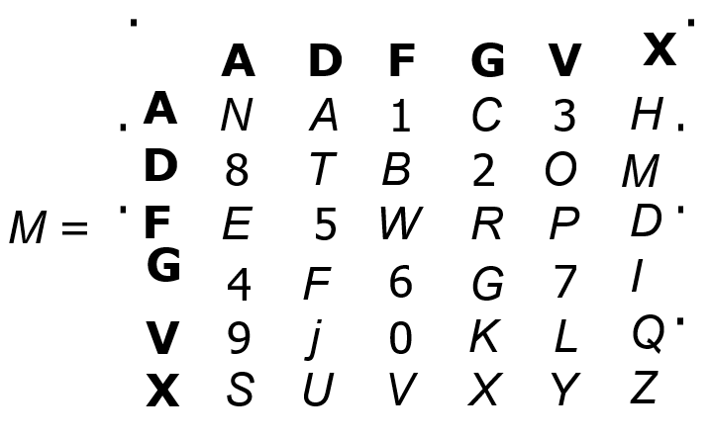
How it works
Step 1: Set up a 6 × 6 matrix M consisting of randomised alphanumeric characters:
Step 2: Break down P into characters:
H E L L O W O R L D

Slide 9
How it works
Step 3: Read the row and column characters from M to encrypt P.
P then becomes:
H E L L O W O R L D
AX FA VV VV DV FF DV FG VV FX

Slide 10
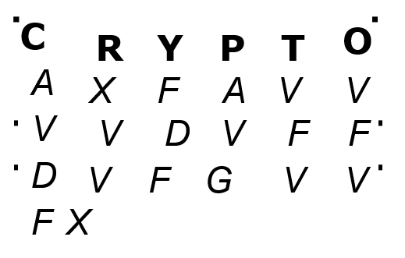
How it works
Step 4: Using K = CRYPTO, transpose the converted text like so:

Slide 11
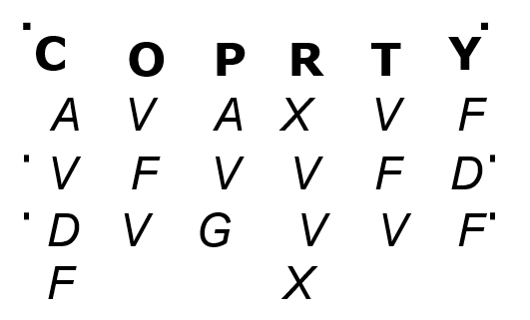
How it works
Step 5: Arrange K in alphabetical order like this:
Step 6: Read the letters by the columns, so the ciphertext then becomes:
AVDF VFV AVG XVVX VFV FDF

Slide 12
ADFGVX Cypher on CrypTool 2
From the CryptTool 2 startup menu, click Cryptography
Then click Classical and then select ADFGVX cipher
In the plaintext section of TextInput, type in: Hello world
Then in the Transposition password box, type in: CRYPTO
Finally click on the Play button to execute

Slide 13
Vernam Cipher

Slide 14
Overview
Invented by Gilbert Vernam in 1918
Features the use of One-time pad
Consists of a plaintext and a key of the same length
Underlying principle: XOR operation

Slide 15
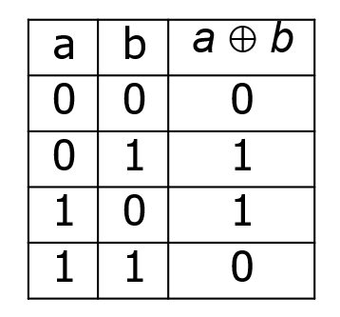
XOR logic recap

Slide 16
Example
For this example, we will use plaintext as P = HELLO with the key K = LEMON
Step1: Convert the key and Plaintext characters to their index number:
HELLO = 7 4 11 11 14 LEMON = 11 4 12 14 13

Slide 17
Example
Step 2: Convert each number of the plaintext into 8 bits:
7 4 11 11 14 (Hello)
00000111 00000100 00001011 00001011 00001110
Step 3: Convert each number of the key into 8 bits:
11 4 12 14 13 (Lemon)
00001011 00000100 00001100 00001110 00001101

Slide 18
Example
Step 4: Convert bitwise XOR operations between P and K :
00000111 00000100 00001011 00001011 00001110
00001011 00000100 00001100 00001110 00001101
--------------------------------------------------------------------
00001100 00000000 00000111 00000101 00000011
What would the resulting ciphertext be?

Slide 19
Vernam Cipher on Cryptool2
From the CryptTool 2 startup menu, click Cryptography
Then click Classical and then select Vernam cipher
In the plaintext section of TextInput, type in any value
Then type in a key value in the Secret Key TextInput box Finally and click on the Play button to execute

Slide 20
Exercise
Create a CryptTool project for a plaintext that:
First encrypts it using ADFGVX Cipher
Then encrypts the ADFGVX Cipher with Vernam Cipher
Then gets the original plaintext back to its original form

Slide 21
Recap
We looked at both ADFGVX and Vernam ciphers
We also looked at how each of them works and how to get them working in CrypTool 2
Next week: Symmetric Encryption

Slide 22
Q&A

